Slide 1
Teaching Civics in a Digital Age?! Slacktivism, Selfie-Humanitarianism, and Agency
Hailey Hancock
haileyhancock@montana.edu
www.educatingexcellence.com

Slide 2
WELCOME!
Logistics and introductions
Overview of content and concepts
Instructional Resource: Project Citizen
Alignment with CCSS ELA/ SS Standards
Exhibit Hall Booth #711; Maria Gallo, gallo@civiced.org
Instructional Resource: Youth and Participatory Politics Framework
Dr. Nam, chaebong_nam@fas.harvard.edu
Critical discussion and reflection
Notes:
The Presentation is posted on NCSS and www.educatingexcellence.com Dr. Danielle Allen is the head of YPP but Dr. Nam, a post-doc fellow, organizes much of the outreach and logistics

Slide 3
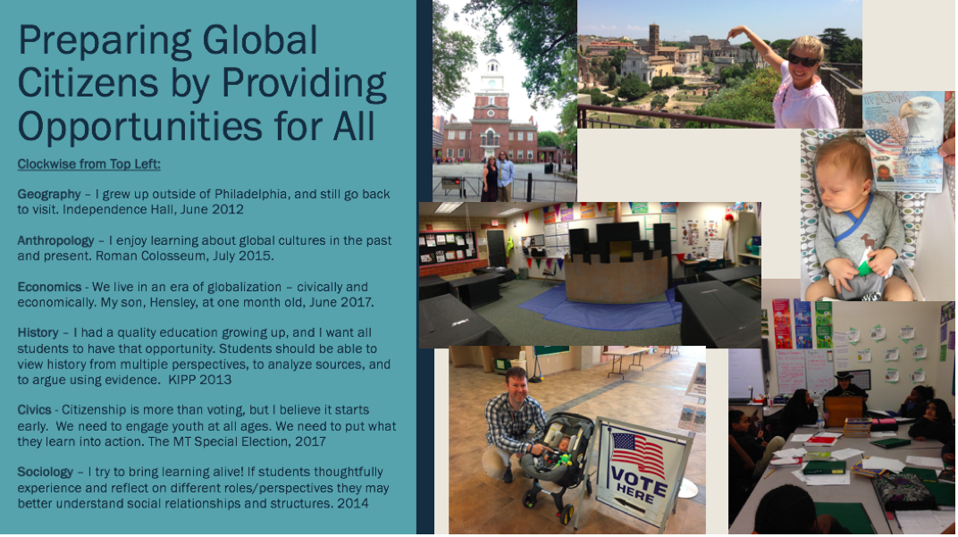
PhotoVoice as a way to explore our identities

Slide 4
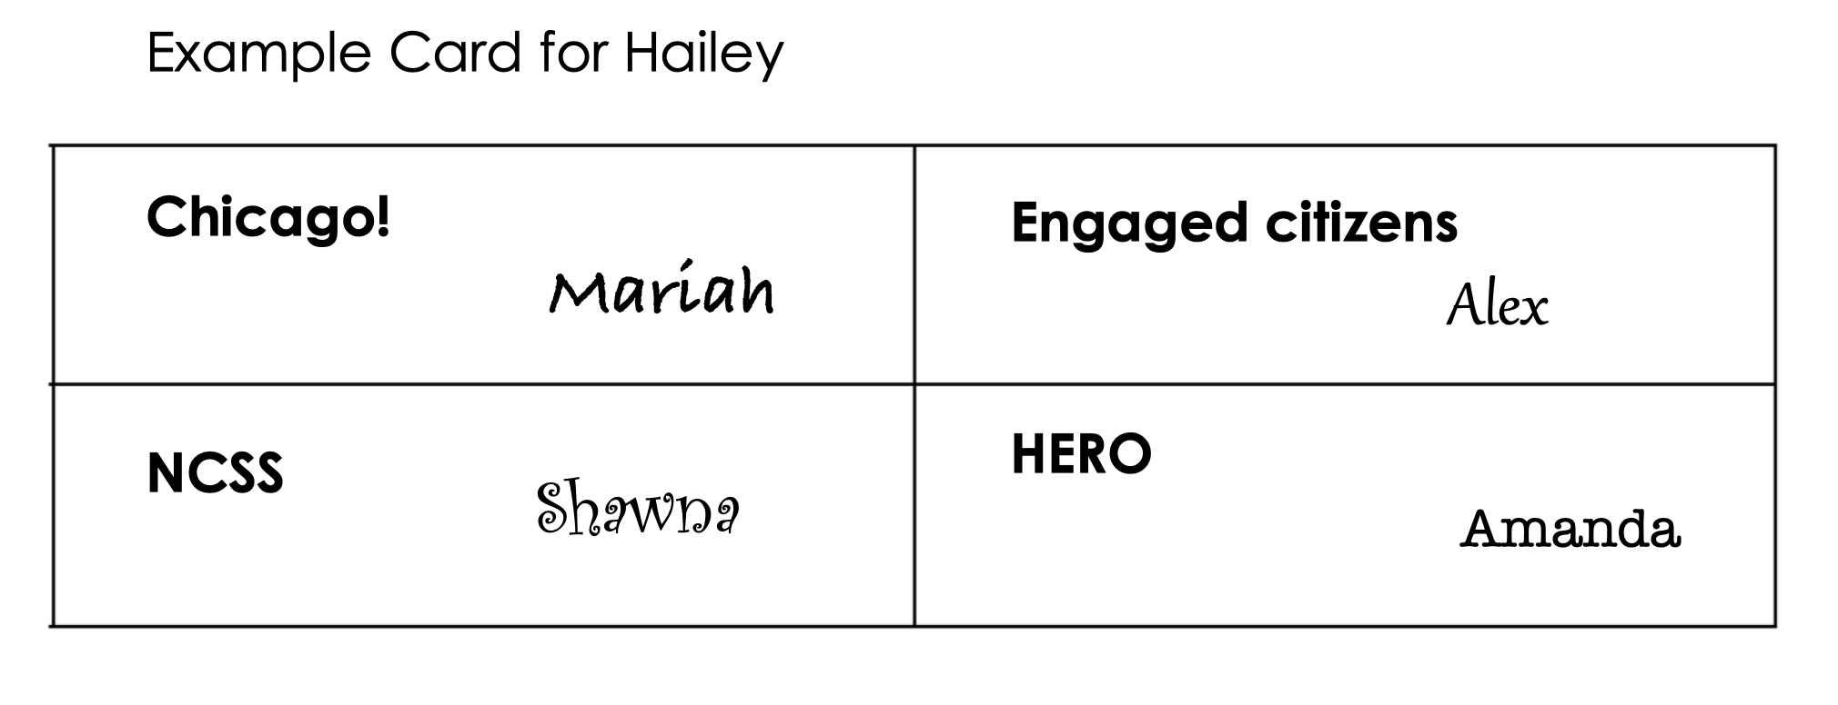
Let’s get to know each other
Find four different “partners” for today’s workshop. 3 of the 4 cannot be in your row / section
Notes:
Stand up if you’re from Chicago – thank you for hosting us – round of applause
Stand up if you’re catching a flight to go home – thank you for traveling to be here – round of applause
Stand up if you have new resources to take back to your classroom – lets give all of our colleagues a round of applause
Stand up if this is your first NCSS conference – lets give them a round of applause
Stand up if this is your first year teaching – round of applause
Stand up if you have taught five or more years – round of applause
Stand up if you have implemented Project Citizen or the YPP Framework –

Slide 5
When you meet with partners throughout the session introduce yourself
Hailey
The “name” of
a student you
teach for – who inspires you!
The state you
currently teach in
The content you teach
i.e. U.S. History, World Geography
The grade(s) you
currently teach

Slide 7
Source: The C3 Framework, p. 41

Slide 8
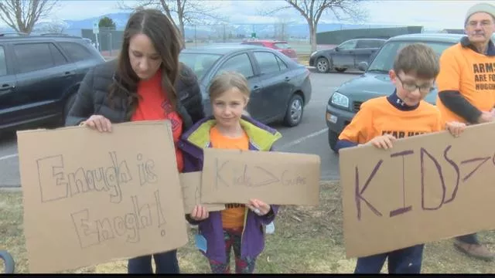
Exercising Constitutional Rights
Our goal is to help students understand:
Issues/events (the context, the law, the problems, multiple perspectives, etc.)
Rights and responsibilities (including limitations and consequences)
The process for creating change in a democracy
Source: http://www.kpax.com/story/37725192/missoula-elementary-school-students-take-part-in-walkout
Notes:
These are photos from elementary school walkout in Missoula; There are three goals of this presentation. First, participants will understand how digital media is changing notions of citizenship and activism. For example: digital platforms change how we receive information and how we engage in our communities. Educators need to understand the transformation that is happening in order to effectively teach civics to our students. Second, participants will be able to identify the ten questions associated with the Youth Participatory Politics (YPP) Framework, and they will see YPP applied to a case study. Third, participants will learn what Project Citizen is, how to get involved in their state, and they will analyze an example middle school project. By the end of this session participants will have an understanding of how citizenship and civic engagement is evolving as well as tools to develop their students into active citizens.

Slide 9
Objectives for our workshop
We will develop a better understanding of how digital media is changing notions of citizenship and activism.
We will learn what Project Citizen is, create a public policy proposal, and analyze an example of a portfolio.
We will identify the ten questions associated with YPP and then analyze a YPP case study.

Slide 10
Civics in the Digital Age
Slacktivism (Allen & Light, 2015; Gladwell, 2010; Karpf, 2012)
Selfie – humanitarianism (Banet-Weiser, 2015; Gill, 2007; Koffman, Orgad, & Gill, 2015)
Empowerment (Hickel, 2014; Zimmerman, 2000) vs. Agency (Allen, 2017)
Participatory politics (Jenkins, 2016; Kahne, 2016)
Participatory Action Research (PAR) and Youth PAR

Slide 11
Selfie-humanitarianism
“The word ‘selfie’ here thus has multiple meanings: it speaks to the key role in which mobile-technology-generated self-portraits – and social media more generally – play in contemporary girl-focused humanitarian campaigns; it captures the turning of the humanitarian gaze away from the those in need and onto the individual donor; and it highlights the reframing of ‘helping others’ in terms of entrepreneurial and narcissistic self-work.”
(Koffman, Orgad, & Gill, 2015, p. 158).
Notes:
This also connects to the savior complex

Slide 12
Agency
Civic agency is defined as the ability or capacity of individuals (and collectives) to participate in their communities.
According to Danielle Allen (2017) there are three types of civic agents:
The civically engaged individual (League of Women Voters)
passionate activists (Occupy, Dreamers, Girl Up)
the politician (local, state, national, international)

Slide 13
Participatory Politics
“… interactive, peer-based acts through which individuals and groups seek to exert both voice and influence on issues of public concern” (Kahne, Hodgin, & Eidman-Aadahl, 2016, p. 2).
There are five characteristics of participatory politics: circulation of information; dialogue and feedback; production of content; mobilization of community members; and investigation of community issues (Jenkins, 2016, p. 43).

Slide 14
Meet with your “Chicago!” partner and discuss. How does technology help or hinder civic engagement? … for us AND our students.

Slide 15
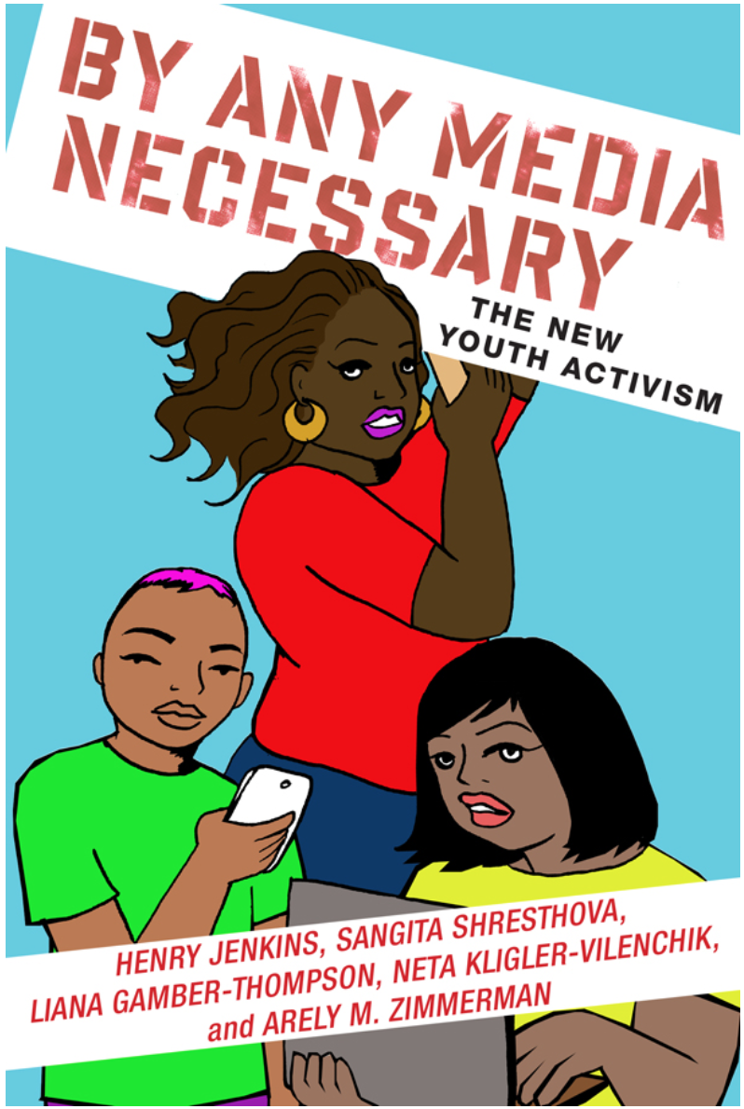
Resource alert!
Click this picture to access a copy for FREE ONLINE (right now)
Notes:
https://www.press.uchicago.edu/ucp/books/book/chicago/F/bo20299131.html
http://connectedyouth.nyupress.org/book/9781479899982/
http://gov.harvard.edu/files/gov/files/gov_94_cz_syllabus_fall_2016-final.pdf

Slide 16
While there are many positive effects/tools associated with technology there are also drawbacks. How can we guide our students in authentically engaging in the process for creating change in a democracy?

Slide 17
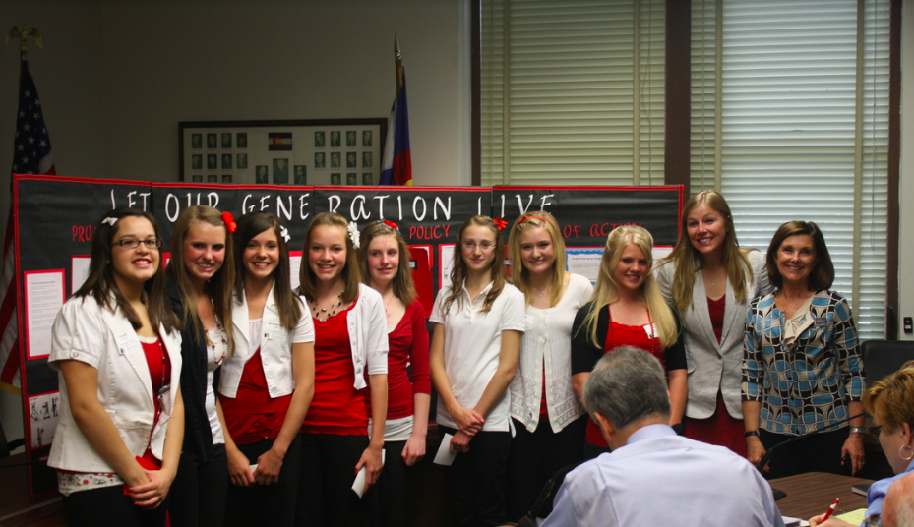
Why I care?
Students want recycling!
Students want less secondhand smoke!
Notes:
With state Senator, Gail Schwartz from 2008 - 2014

Slide 18
Project Citizen: online “textbook” from the Center for Civic Education
PRE-TEACH and INTRODUCE PUBLIC POLICY then…
Identify the problem and gather information
Examine alternative policies
Propose one public policy with reasoning
Develop an action plan
PRESENT and REFLECT on the experience
Notes:
Video: https://www.youtube.com/watch?v=nxCt4J0TUew&feature=youtu.be

Slide 19
What is public policy?
pages 1 – 5 in Project Citizen online “textbook”
“…An agreed-upon way that our federal, state, or local governments fulfill their responsibilities, such as protecting the rights of individuals and promoting the general wellbeing of the people.” (p. 4)
Example: police officers enforce speed limits
NON – Example: food drives, volunteering
Let’s practice with our “Engaged citizen” partner – reintroduce yourself and share your favorite food then complete this policy worksheet together

Slide 20
Public Policy Worksheets
Now lets “snowball”
One group joins with another group to discuss their answers
Think about the different levels of government involved in creating policy
Some public policies are written into laws by legislatures (i.e., Congress, State Legislatures, City Councils, School Boards, etc.).
Other policies are contained in rules and regulations created by executive branches of government (i.e., President, Governor, Mayor, School Superintendent, etc.), the branches of government responsible for carrying out and enforcing laws.
Resource: Tennessee Center for Civic Engagement

Slide 21
Let’s apply Project Citizen
Find your “NCSS” partner
We will review an example of creating public policy using a nursery rhyme
Then choose a nursery rhyme
Read it critically and connect it to our world today at the local, state, national or global level
Fill out your handout on public policy
This website could help be helpful

Slide 22
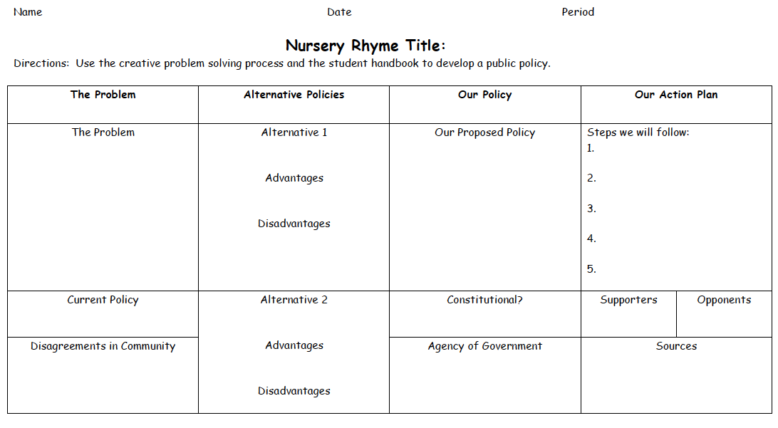
TASK: You are going to have 20 minutes to analyze a nursery rhyme, and create public policy around the issue presented in their nursery rhyme.
If you would like to share reach out to Hailey… we will take a picture of your work and AirDrop it …
Notes:
Show an example of a complete project. - http://www.civiced.org/digitalPortfolio/

Slide 23
Source: https://www.doe.k12.de.us/cms/lib/DE01922744/.../ProjectCitizen_6-8_5-09.doc

Slide 24
Let’s share out

Slide 25
Explore a Project Citizen Portfolio
With your NCSS partner go to the sample portfolio
Click on the first “board”. What is their problem?
Click on the second “board”. What stands out to you from the alternative policies?
Click on the third “board”. What support to they have for their chosen policy?
Click on the fourth “board”. What stood out to you about their action plan?

Slide 26
Project Citizen: Strat Chat
STAY WITH YOUR NCSS PARTNER…
How were the 5 E’s integrated into this project?
Engage? Explore? Explain? Elaborate? Evaluate?
What are some other pre-teaching activities that need to happen before students jump into creating their official Project Citizen project?
How are activities like Project Citizen different than a traditional research project? Why does this matter?
Skim pages 30, 32, 34 and 38 to review how students complete parts 1 – 4 on the Display Board. Why is it important for students to present their findings to a real audience?
Notes:
Pass the Butcher Paper
Students sit in small groups. In front of each group is a piece of butcher paper with a different character or topic written on it. The students write down what they know about that character or topic so far. They pass the butcher paper clockwise, read the notes written, and add to it. This procedure continues until all students have written on each piece of butcher paper.

Slide 27
Youth Participatory Politics
Investigation
Dialogue/Feedback
Circulation
Production
Mobilization
https://ypp.dmlcentral.net/pages/about

Slide 28
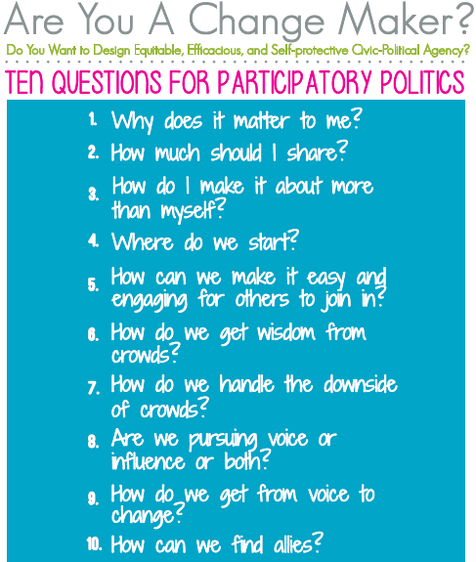
The YPP Action Framework
(Allen, Earl, and Soep)
Notes:
Dr. Danielle Allen at Harvard – political theorist
Dr. Jennifer Earl at University of Arizona – sociologist
Dr. Elisabeth (Lissa) Soep, PhD (Stanford) is Research Director and Senior Producer at Youth Radio, a national youth-driven production company in Oakland, CA

Slide 29
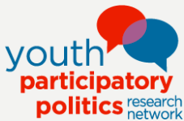
A Case Study of Girl Up Using the Youth and Participatory Politics Framework

Slide 30
Overview
Theory
Our Case
Analysis
The Girl Effect
The Global Goals
Girl Up, a campaign of the United Nations Foundation
Civic Agency
Empowerment
Youth and Participatory Politics (YPP) Framework
Participatory Action Research (PAR) and YPAR
Visual methodologies
Instagram and Facebook
Themes
Further Research

Slide 31
Our Case
Purpose:
“We exist to create a new normal with and for girls… We work with girls and those around them to create active champions of a world in which she reaches her full potential and the cycle of poverty is disrupted”
The Girl Effect and Girl Up
Source: http://www.girleffect.org/our-purpose/

Slide 32
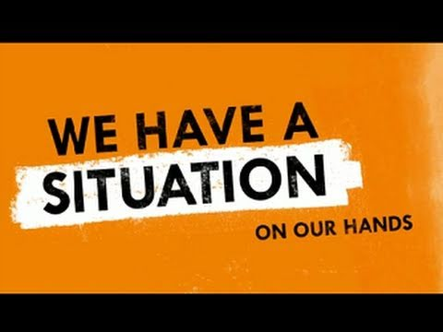
“The Clock is Ticking” (2009) - The Girl Effect started in 2004 as a campaign of the NIKE Foundation
Notes:
From the launch of the Girl Effect Film "The Clock is ticking" at the World Economic Forum in Davos in 2009, to our collaborations with the Novo Foundation, the United Nations Foundation and multiple partners, we've challenged people to think differently about girls.

Slide 33
Source: http://www.girleffect.org/what-girls-need/articles/2016-insights-inspiration/the-girl-declaration/
#GirlDeclaration
2013
Notes:
In 2013 we made it our mission to secure girls’ place in the Global Goals for Sustainable Development.
These goals are the successor of the Millennium Development Goals (MDGs), a set of 15-year targets put in place by UN member states to address and reduce poverty. Girls were left out of the original MDGs. We set out to put that right.
So, on 1 October 2013 we launched the Girl Declaration, a call for girls’ voices everywhere to be heard.
The Declaration was created in partnership with 25 development organisations, and in consultation wit more than 500 girls in 14 countries, across four continents.
It was the first time policy experts and girls themselves had united, ensuring girls’ real needs were identified and included in the SDGs.

Slide 34
Global Goals (SDGs) 2030
“In September 2015, 193 world leaders agreed to 17 Global Goals for Sustainable Development. If these Goals are completed, it would mean an end to extreme poverty, inequality and climate change by 2030.
The Global Goals are only going to work if we fight for them and you can’t fight for your rights if you don’t know what they are. We believe the Goals are only going to be completed if we can make them famous.”
Source: http://www.globalgoals.org
Notes:
Goal five (of 17): Achieve gender equality and empower all women and girls.
Goal 5 Targets
End all forms of discrimination against all women and girls everywhere
Eliminate all forms of violence against all women and girls in the public and private spheres, including trafficking and sexual and other types of exploitation
Eliminate all harmful practices, such as child, early and forced marriage and female genital mutilation
Recognize and value unpaid care and domestic work through the provision of public services, infrastructure and social protection policies and the promotion of shared responsibility within the household and the family as nationally appropriate
Ensure women’s full and effective participation and equal opportunities for leadership at all levels of decision making in political, economic and public life
Ensure universal access to sexual and reproductive health and reproductive rights as agreed in accordance with the Programme of Action of the International Conference on Population and Development and the Beijing Platform for Action and the outcome documents of their review conferences
Undertake reforms to give women equal rights to economic resources, as well as access to ownership and control over land and other forms of property, financial services, inheritance and natural resources, in accordance with national laws
Enhance the use of enabling technology, in particular information and communications technology, to promote the empowerment of women
Adopt and strengthen sound policies and enforceable legislation for the promotion of gender equality and the empowerment of all women and girls at all levels

Slide 35
Is
it that easy?
Screenshot taken from: http://www.globalgoals.org/girls-progress/

Slide 36
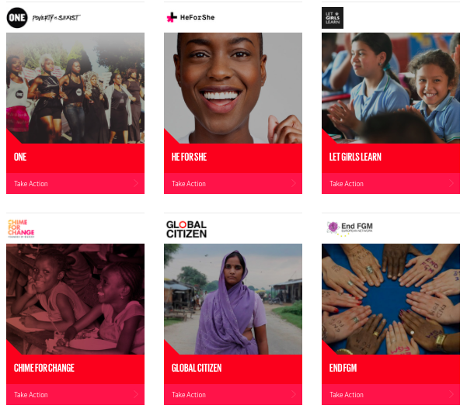
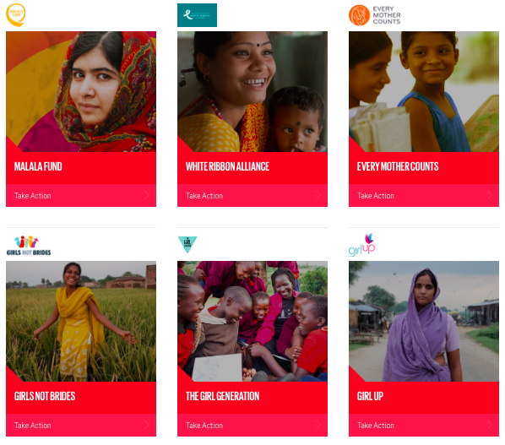
Take action with one of these campaigns
All campaign images are from: http://www.globalgoals.org/girls-progress/

Slide 37
Girl Up Mission and Vision
Mission - Girl Up ignites the empowerment of girls, by girls around the world. In partnership with the United Nations, we stand up for girls, speak up for programs that help them thrive and rise up as a community of global advocates out to change the world, for good.
Vision - Girl Up envisions a world where every girl can reach her full potential. A world where girls lead the way to bigger dreams and happier days, healthier communities and stronger nations. A world where girls are empowered and a future that is better because of them.
Source: Girl Up Branding Guide, 2017

Slide 38
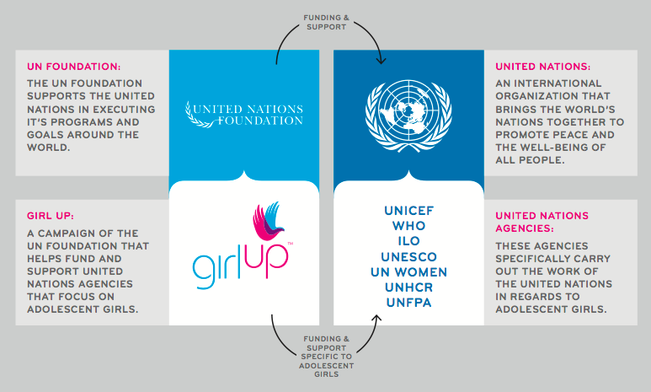
How Girl Up is connected to the United Nations
Source (this slide): https://girlup.org/about/un-un-foundation/#sthash.bDCIxaM3.dpbs
Source (next slide): https://girlup.org/resources/#sthash.dNdSHq4R.dpbs

Slide 40
Findings from the content analysis of Facebook and Instagram
Themes:
Girl Up advocates for human rights issues.
Girl Up advertises campaign events.
Girl Up relies on celebrities and/or field experts, often labeled #GIRLHERO.
Girl Up relies on brands and companies to support initiatives.
Girl Up is using social media to influence politics.
Girl Up includes females from a variety of racial and geopolitical backgrounds.

Slide 41
Now lets have YOU apply the YPP action framework

Slide 42
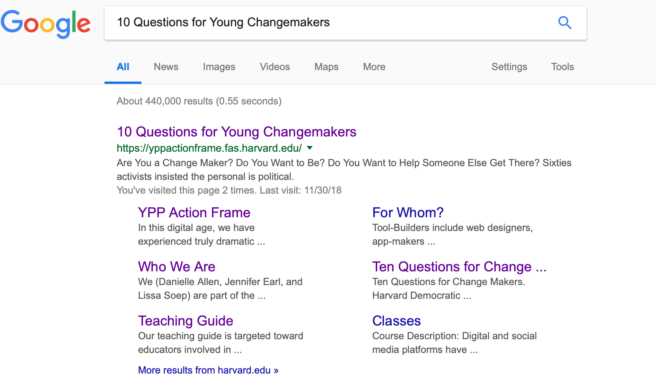
Choose one case study to analyze
You can go to this link or Google “10 Questions for Change Makers” and click Teaching Guide
https://yppactionframe.fas.harvard.edu/files/actionframe/files/teaching_guide-ver.1_june20-2017.pdf

Slide 43
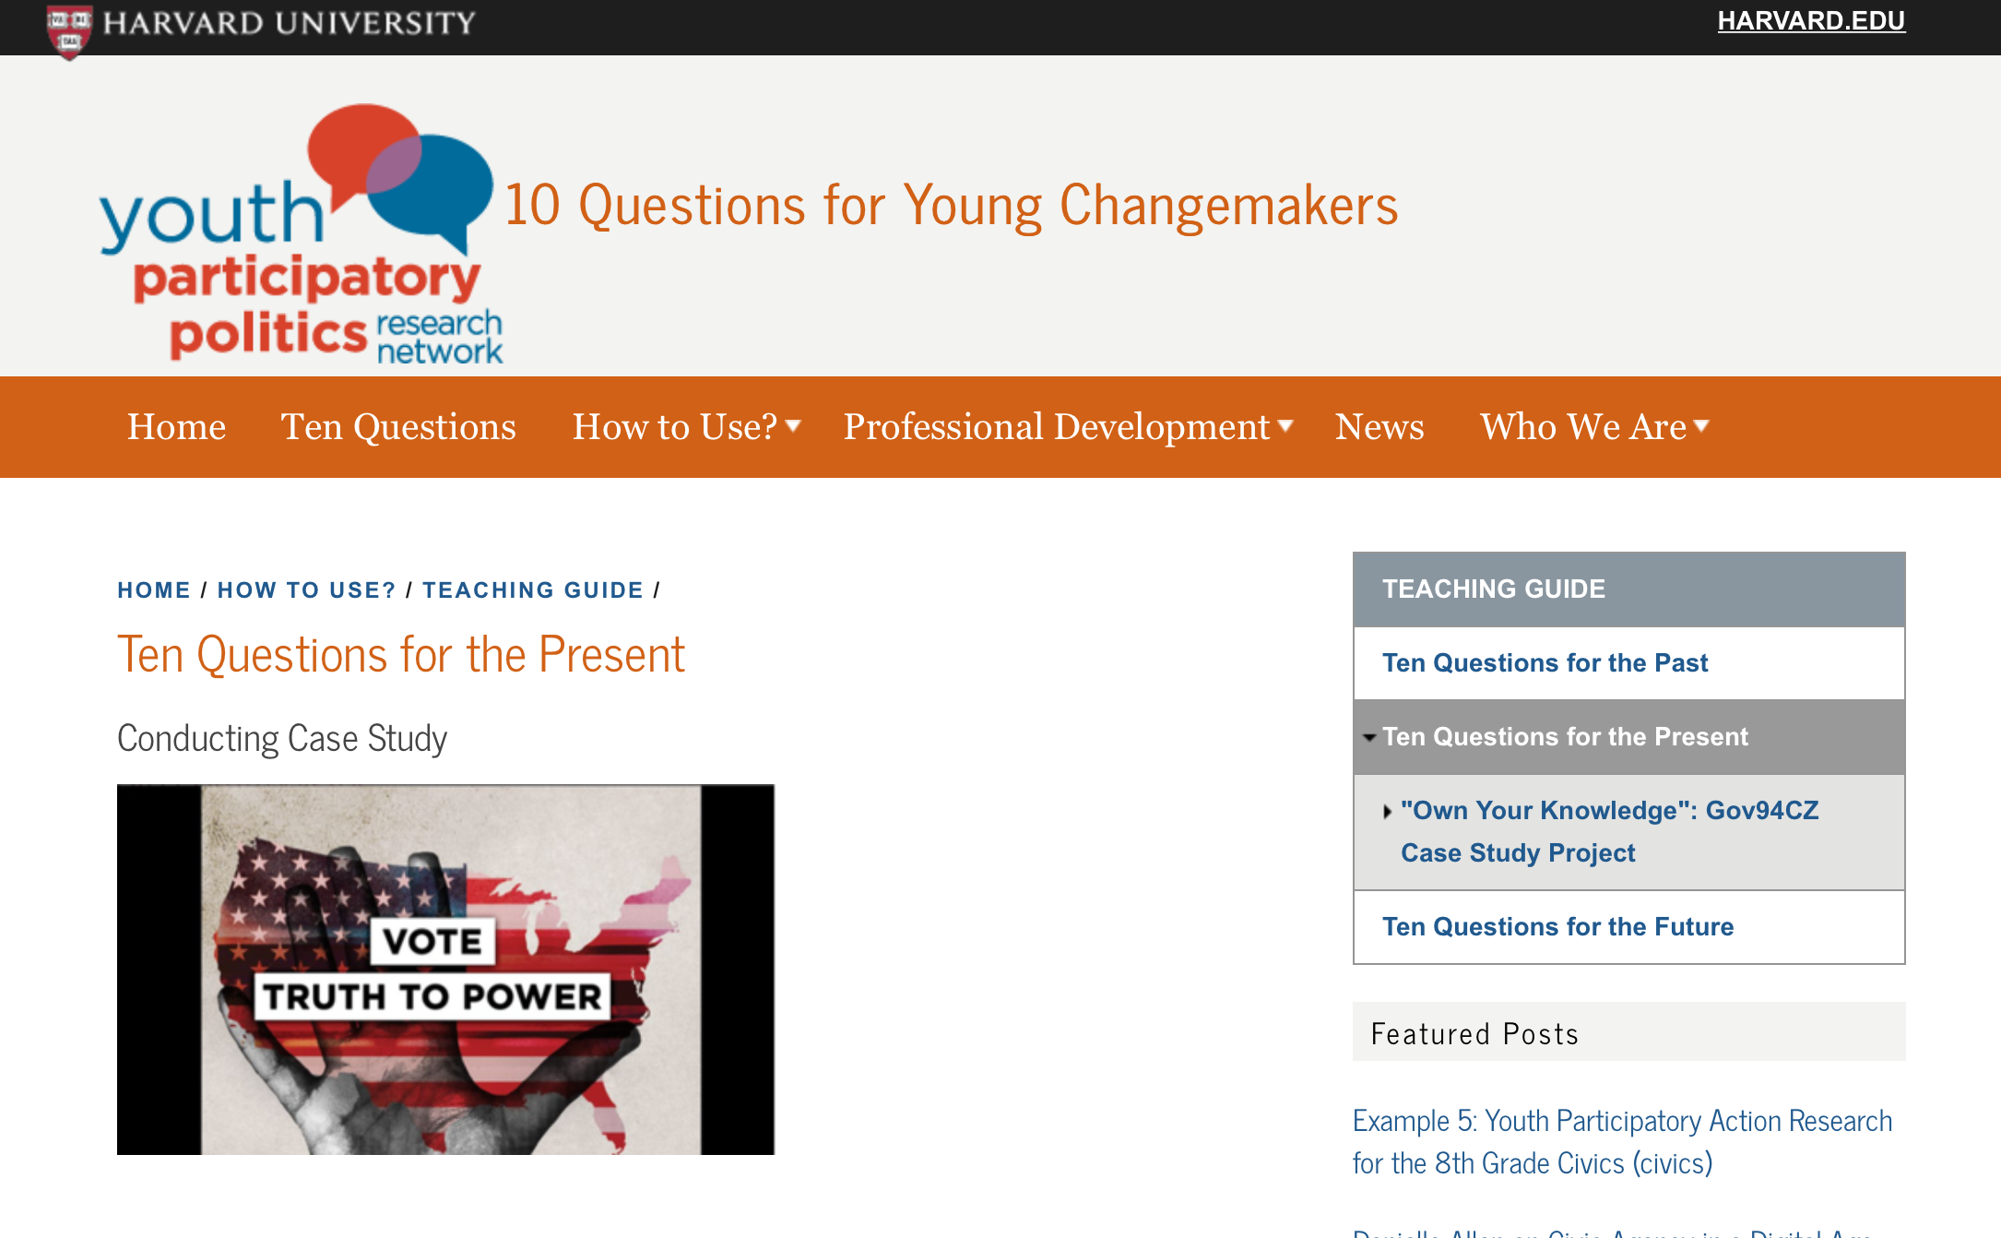

Slide 44
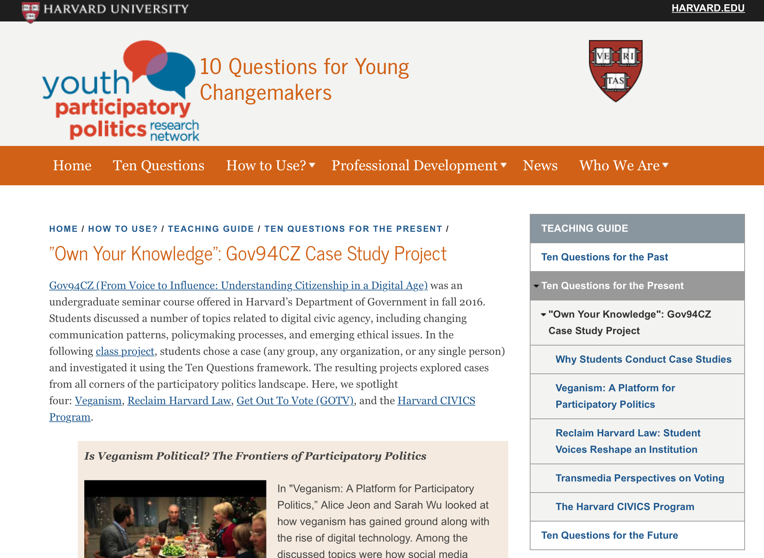

Slide 45
Work with your “HERO” partner to analyze one case study
Answer these questions as you go:
How is the YPP Framework being applied? (see handout for the 10 YPP questions)
How do you think you would scaffold this for your students?
What issues/events (the context, the law, the problems, multiple perspectives, etc.) could your students apply YPP to?
How do you think YPP teaches rights and responsibilities (including limitations & consequences)?
How does YPP help students understand the process for creating change in a democracy, and how is it changing due to technology?

Slide 46
Critical Discussion and Reflection

Slide 47
Objectives for our workshop
We will develop a better understanding of how digital media is changing notions of citizenship and activism
We will learn what Project Citizen is, create a public policy proposal, and analyze an example of a portfolio.
We will identify the ten questions associated with YPP and then analyze a YPP case study.

Slide 48
Other Civics Resources
10 Supreme Court Cases Every Teen Should Know
The Annenberg’s Best Civics Sites
The Constitution Center
Common Sense Media – Media Literacy
CSPAN Student Cam
Fantasty Government created by Jay Colombo
iCivics – Sandra Day O’Connor*** AMAZING!
National Archives – America’s Founding Documents or DocsTeach
YPP Action Framework by teacher, Melissa Strelke
Curriculum ($) – Generation Citizen, HistoryAlive!

Slide 49
Selected References
Allen, D. S., & Light, J. S. (2015). From voice to influence: Understanding citizenship in a digital age.
Chicago, IL: The University of Chicago Process.
Banet-Weiser, S. (2015). ‘Confidence you can carry!’: Girls in crisis and the market for girls’
empowerment organizations, Continuum, 29(2), 182-193.
Center for Civic Education. (2018). Project Citizen. Retrieved from http://www.civiced.org/pc-
program/resources/resource-center
Girl Up! Global Goals. (2017). Girls progress = goals progress. The United Nations.
http://www.globalgoals.org/girls-progress/
Jenkins, H. (2016). By any media necessary: The new activism of American youth. New
York, NY: University Press.
Koffman, O., Orgad, S., & Gill, R. (2015). Girl power and ‘selfie humanitarianism’, Continuum, 29(2),
157-168.
Youth and Participatory Politics. (2017). Ten questions. The President and Fellows of
Harvard College. Retrieved from https://yppactionframe.fas.harvard.edu/teaching-guide-ten-
questions
Zimmerman, M. (2000). Empowerment theory: Psychological, organizations and
community levels of analysis. In Rappaport, J. & Seidman, E. (Eds.), Handbook of
community psychology (46-63). New York, NY: Kluwer/Plenum.

Slide 50
Thank you for your engagement, Hailey Hancock haileyhancock@montana.edu www.educatingexcellence.com Project Citizen - Maria Gallo, gallo@civiced.org Youth and Participatory Politics Framework - Dr. Nam, chaebong_nam@fas.harvard.edu

